Slide 1
Introduction to Deep Learning with Tensorflow
Week 10, Day 2

Slide 2

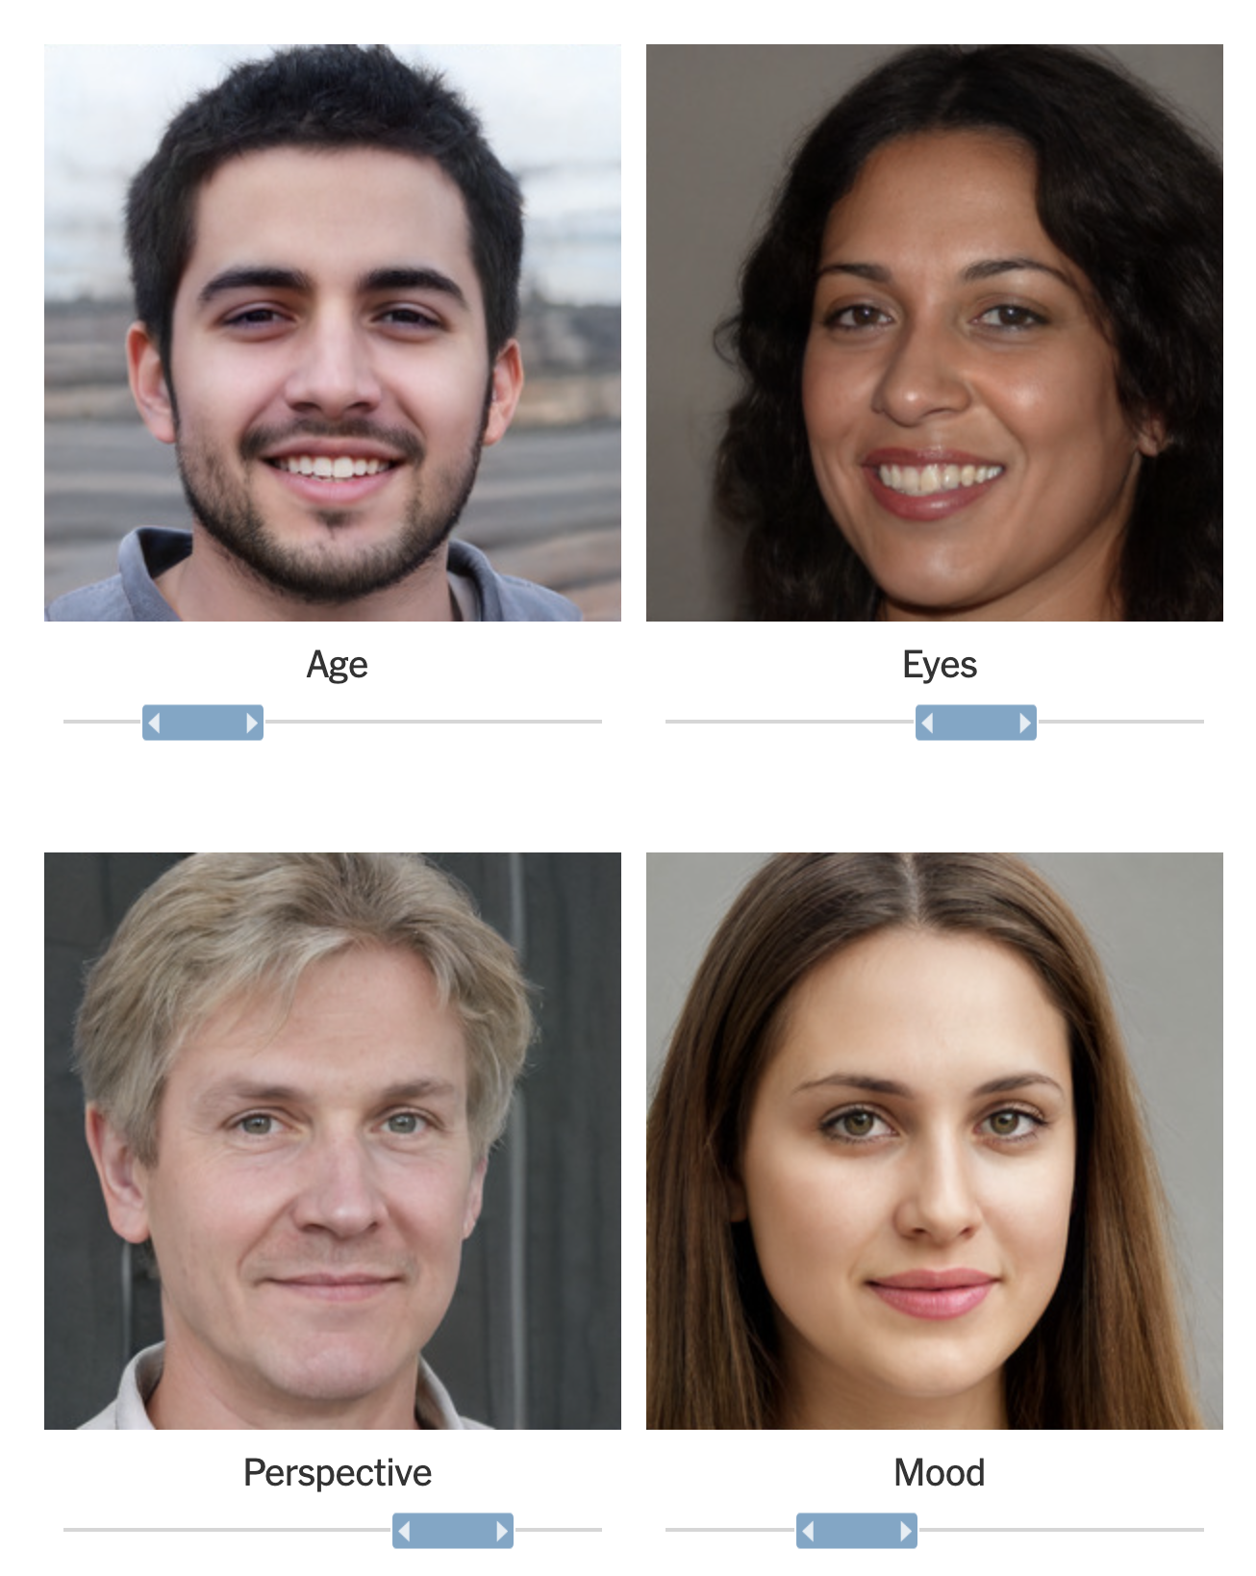
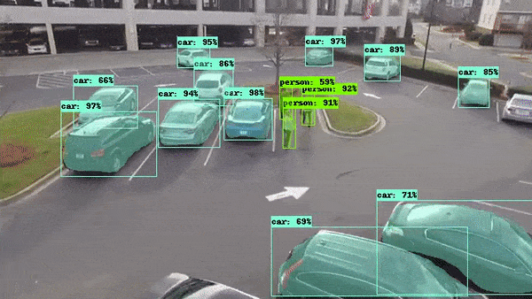
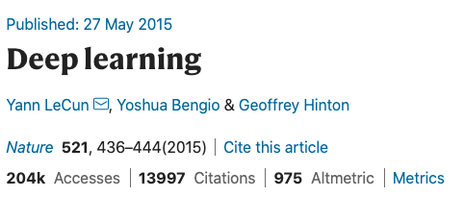
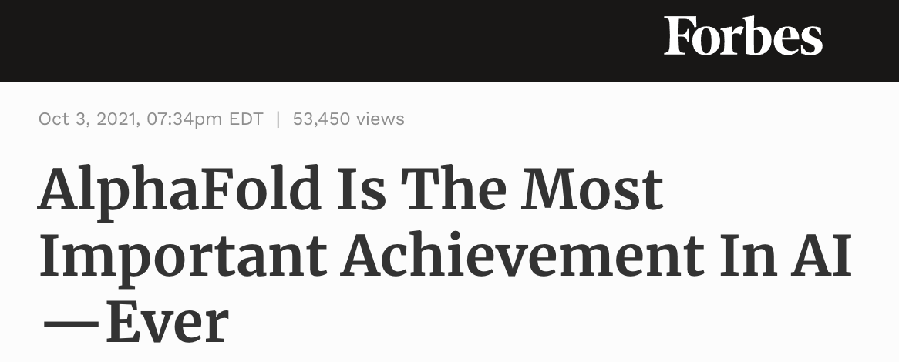
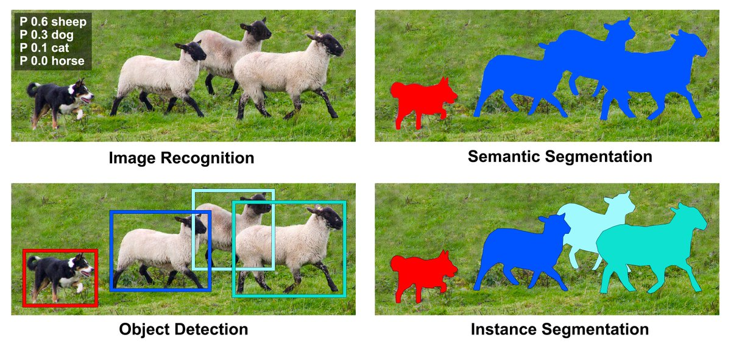

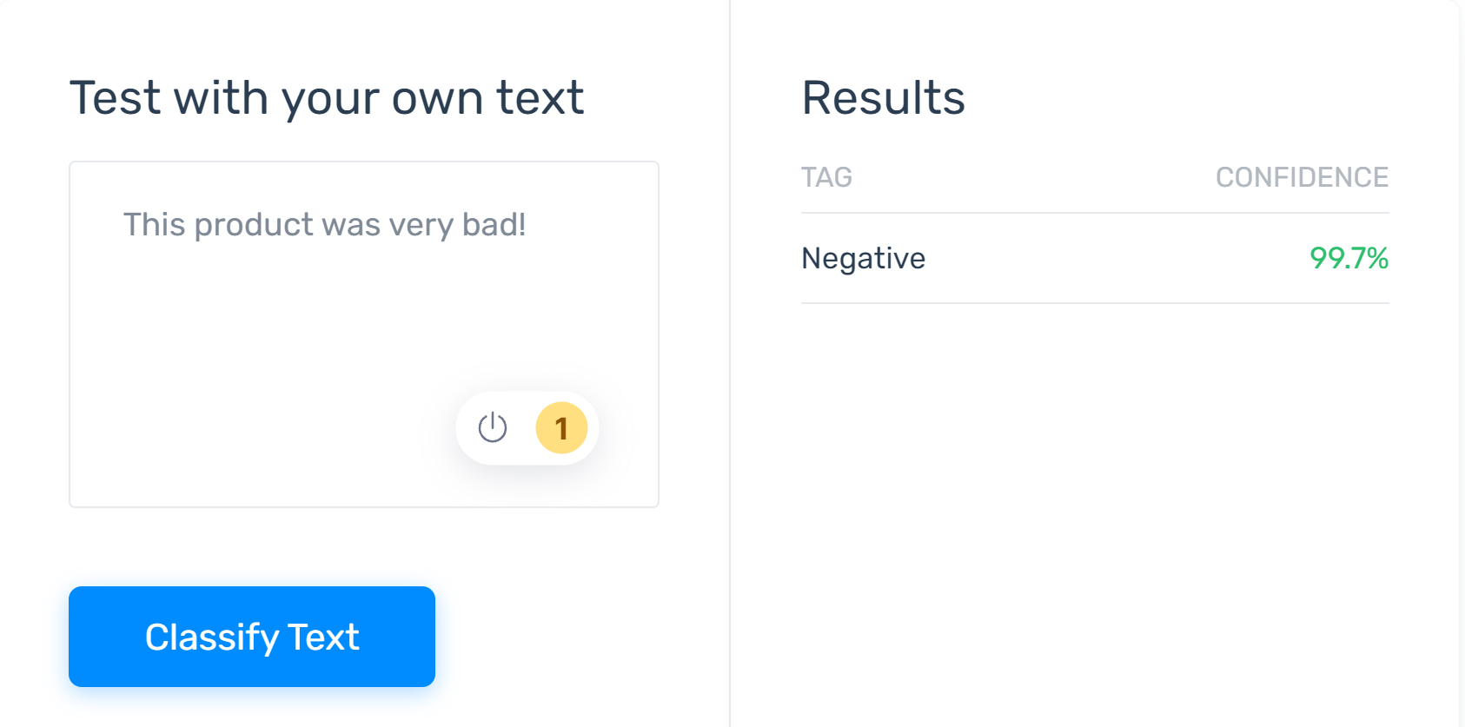

Deepfake Generation: Forbes Article
https://www.forbes.com/sites/robtoews/2021/10/03/alphafold-is-the-most-important-achievement-in-ai-ever/
37% of tech organizations use AI!
Sentiment Analysis of reviews.

Slide 3
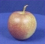
The machine learning framework
y = h(x)
Training: given a training set of labeled examples {(x₁,y₁), …, (x_{N},y_{N})}, estimate the prediction function h by minimizing the prediction error on the training set
Testing: apply h to a never before seen test example x and output the predicted value y = h(x)
h(. ) = “apple”
output
prediction function
Image feature

Slide 4
Deep Learning Pipeline
Step 1
Step 2
Step 3
Step 4
Step 5
Load and Preprocess Data
Data Visualization
Design the Deep Learning Model
Train the Model
Define
Evaluate the Model

Slide 5
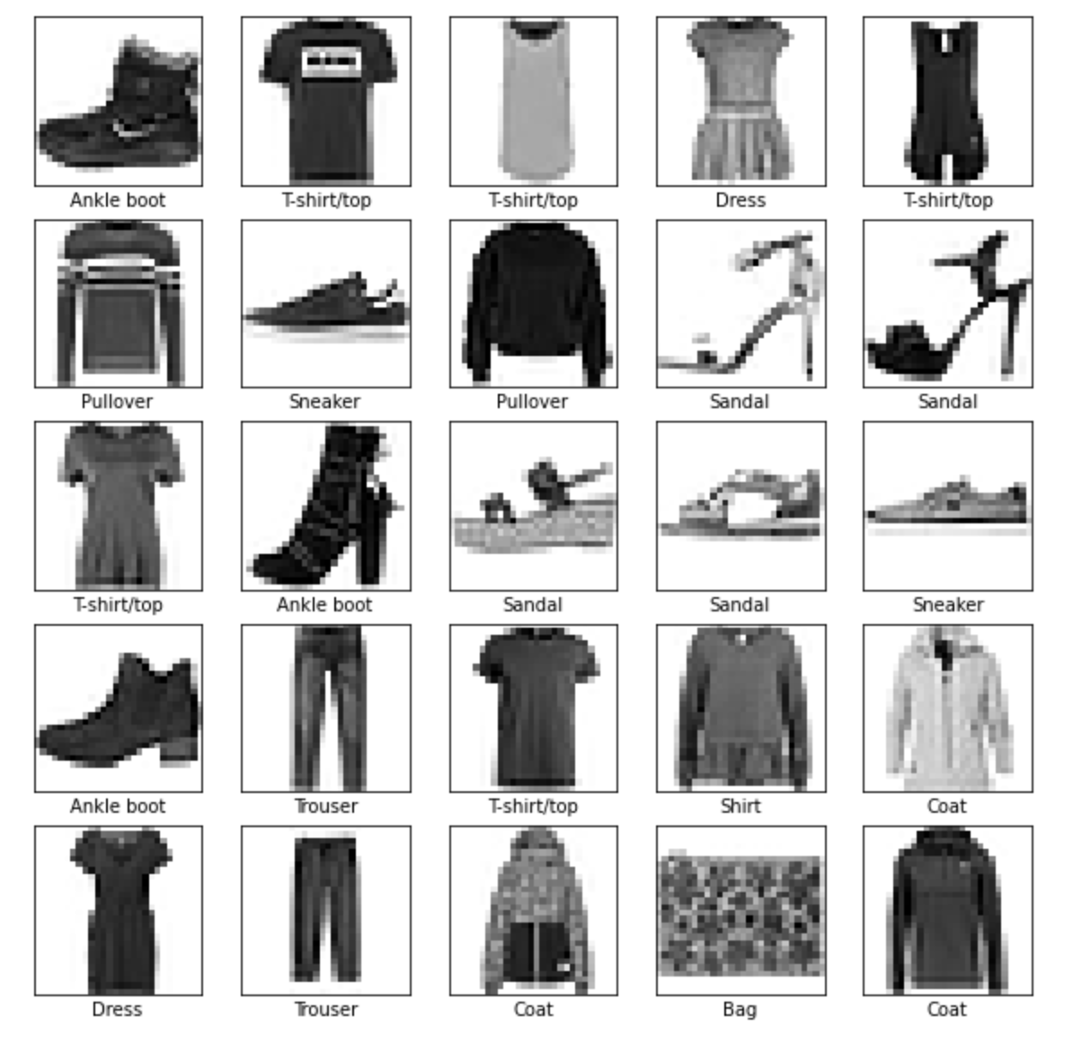
Agenda
For this exercise, we will use Fashion MNIST dataset to classify the clothing in an image. We will follow the 6-step pipeline to design our neural network.

Slide 6
Step 1: Load and Preprocess the Data
Task 1: Download/fetch the dataset.
Task 2: Split the dataset to training and testing datasets.
Task 3: Normalize and preprocess the datasets.
# task 1: download/fetch the dataset
fashion_mnist = tf.keras.datasets.fashion_mnist
# task 2: split the dataset to training and testing datasets (train_images, train_labels), (test_images, test_labels) = fashion_mnist.load_data()
# task 3: normalize and preprocess the datasets.
train_images = train_images / 255.0 test_images = test_images / 255.0
train_images = train_images.reshape(-1, 28*28)
test_images = test_images.reshape(-1, 28*28)

Slide 7
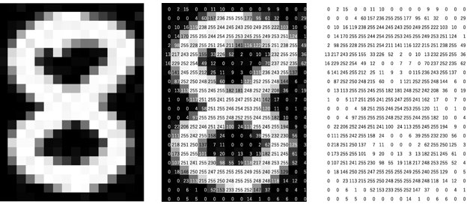
The AI needs to see!
Human vision is a complex phenomena starting with the light rays entering through cornea of the eye and the visual cortex making sense of the various signals it receives.
However, computers speak only numbers. Hence, images are represented as numbers, usually in intensities ranging from 0 to 255.

Slide 8
0 1 2 3 4 5 6 7 8 9 … column indices.

Slide 9
Step 1, Task 2: Training and Testing Data Splits for Generalization of the Model
Training Labels
How well does a learned model generalize from the data it was trained on to a new test set?
Generalization refers to your model's ability to make correct predictions on new, previously unseen data as opposed to the data used to train the model.
Training Data
h
Training
Learned model
Testing Data
h
Learned model
Prediction

Slide 10
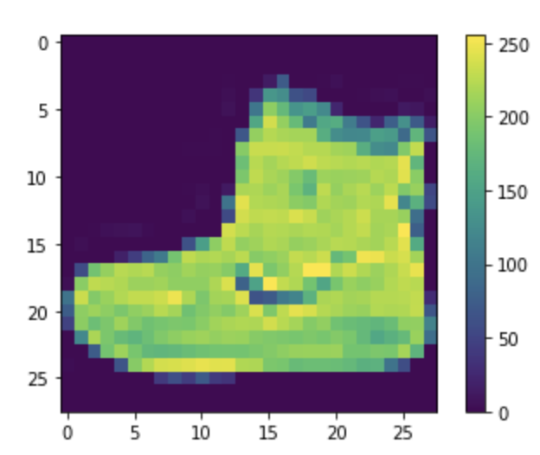
Step 2: Data Visualization
It is important to visualize some samples from the dataset. This allows us to verify the data as well as visually inspect the differences between different classes in the dataset.
plt.figure() plt.imshow(train_images[0]) plt.colorbar() plt.grid(False) plt.show()

Slide 11
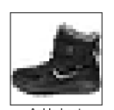
Step 3: Design the Deep Learning Model
INPUT: Flattened Image (1x784)
Hidden Layer
Hidden Layer
Softmax
28
Ankle Boot
28
10
W [128 x 10 ]
128
W [784 x 128 ]
model = tf.keras.Sequential([
tf.keras.layers.Dense(128, activation='relu’, input_shape=(784,)),
tf.keras.layers.Dense(10, activation='softmax’)
])

Slide 12
Step 4: Train the Deep Learning Model
model.compile(optimizer='adam’,
loss=tf.keras.losses.SparseCategoricalCrossentropy(from_logits=False),
metrics=['accuracy’])
model.fit(train_images, train_labels, epochs=10)

Slide 13
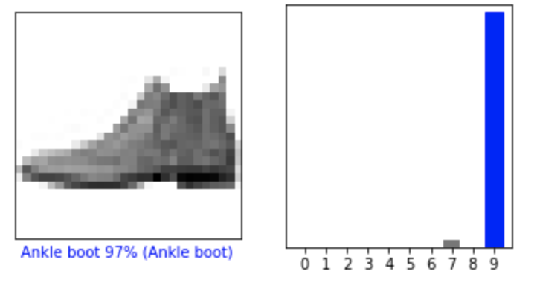
Step 5: Evaluate the Model
test_loss, test_acc = model.evaluate(test_images, test_labels, verbose=2)
print('\nTest accuracy:', test_acc)
i = 0
plt.figure(figsize=(6,3))
plt.subplot(1,2,1)
plot_image(i, predictions[i], test_labels, test_images.reshape(-1, 28,28))
plt.subplot(1,2,2)
plot_value_array(i, predictions[i], test_labels)
plt.show()

Slide 14
New Model Architectures (Steps 3,4 & 5)
INPUT: Flattened Image (1x784)
Hidden Layer 1
Hidden Layer 2
Softmax
28
Ankle Boot
28
10
model = tf.keras.Sequential([
tf.keras.layers.Dense(128, activation='relu’, input_shape=(784,)),
tf.keras.layers.Dense(64, activation='relu’),
tf.keras.layers.Dense(10, activation='softmax')
])
128
64

Slide 15
New Model Architectures (Steps 3,4 & 5)
INPUT: Flattened Image (1x784)
Hidden Layer 1
Hidden Layer 2
Hidden Layer 3
Softmax
model = tf.keras.Sequential([
tf.keras.layers.Dense(128,
activation='relu’,
input_shape=(784,)),
tf.keras.layers.Dense(64, activation='relu’),
tf.keras.layers.Dense(32, activation='relu’),
tf.keras.layers.Dense(10, activation='softmax')
])
28
Ankle Boot
28
10
128
64
32

Slide 16
Terminology
https://developers.google.com/machine-learning/glossary
Batch | The set of examples used in one iteration (that is, one gradient update) of model training.
Batch size | The number of examples in each batch.
Epoch | The number of times we cover the entire dataset during training. Steps in each epoch = Total samples / batch size.
Activation function | A function (for example, ReLU or sigmoid) that takes in the weighted sum of all of the inputs from the previous layer and then generates and passes an output value (typically nonlinear) to the next layer.
Iteration | A single update of a model's weights during training. An iteration consists of computing the gradients of the parameters with respect to the loss on a single batch of data.
Dense or Fully Connected Layer | A hidden layer in which each node is connected to every node in the subsequent hidden layer.
Generalization | Refers to your model's ability to make correct predictions on new, previously unseen data as opposed to the data used to train the model.
Hidden Layer | A synthetic layer in a neural network between the input layer (that is, the features) and the output layer (the prediction). Hidden layers typically contain an activation function (such as ReLU) for training.

